Slide 1
Chapter 4
Shell Scripting
Notes:
sudo apt update && sudo apt upgrade -y

Slide 2
At the end of this lesson, students will be able to:
Explain the fundamentals of shell scripting
Describe basic scripting concepts and their applications.
Write and execute simple shell scripts effectively.
Apply practical scripting techniques in various scenarios,

Slide 3
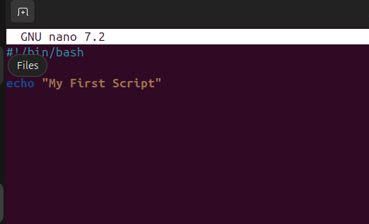
What is Shell Script?
-a shell script is a simply a file that contains a list of commands. It’s like a to-do list for your computer! Instead of typing each command individual, you can write them all in single file.
Notes:
The shell (like Bash) acts as a command interpreter. Instead of typing commands one-by-one, you write them in a file (e.g., script.sh) and execute it to automate tasks like backups, file management, or software installations.

Slide 4
Basic Scripting Concepts
Shebang (#!/bin/bash): this is the line that start #! (called a shebang). It tells the system to use the bash shell to interpret the script and /bin/bash is the path to bash. So, when the scripts run, it knows exactly which shell to use
Comments (#): Add notes in your code.
Variables: name="Jerico"
Echo: Output something → echo "Hello, $name"
Notes:
The shebang is always the first line. Comments are ignored by the shell but helpful for documentation. Variables store data, and echo displays outp
A shebang is the character sequence #! at the very top of a script file, followed by the path to the interpreter that should run the script.ut.

Slide 5
The two most common shells are:
Bash (Bourne Again Shell) – Default on most Linux systems.
zsh (Z Shell) – Popular for its customization, used by default in macOS.

Slide 6
Writing Your First Script
#!/bin/bash
name="Jerico"
echo "Hello, $name! Welcome to scripting."
How to run it:
bash script.sh
Notes:
chmod +x hello.sh
./hello.sh
You give the script execute permission using chmod +x. Then run it with ./. This script prints a greeting using a variable.
or
bash script.sh
sh script.sh
zsh script.sh

Slide 7
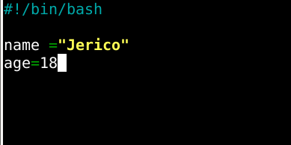
Basic Shell Scripting (Variables)

Slide 8
Environment Variables
-these are variables that stick around for the system or across scripts.
echo "Home Directory: $HOME"
echo "Username: $USER"
echo "Current Shell: $SHELL"
echo "Present Working Directory: $PWD"
echo "Random Number: $RANDOM"
echo "Seconds since script started: $SECONDS"

Slide 9
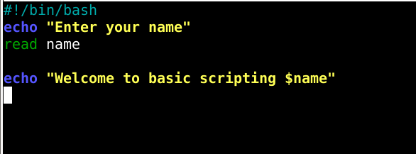
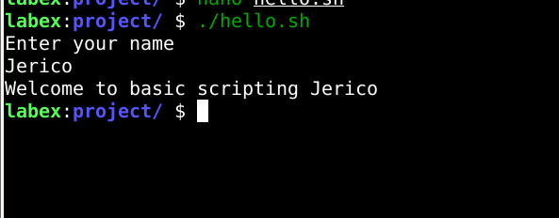
Basic Shell Scripting (Output and Input)
Notes:
\t fpr tab \n for new line
Display literal back lash is need \\
You can improve a simple read command to ask for first name and last name like this:
bash
CopyEdit
#!/bin/bash
read -p "Enter your first name: " fname
read -p "Enter your last name: " lname
echo "Hello, $fname $lname!"
Add –s like
read –s –p “Enter your pass” help to hid the password

Slide 10
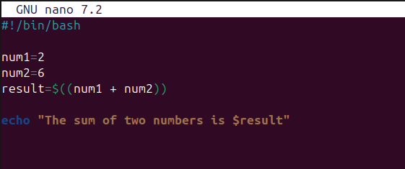
Basic Shell Scripting (Arithmetic and Mathematical Operators)
-bash scripting doesn’t do direct math, so you need $((expression)) to handle calculations.

Slide 11
Basic Shell Scripting (Comparison Operators)
Operator | Meaning | Example
-eq | Equal to | [ 5 -eq 5 ]
-ne | Not equal to | [ 5 -ne 3 ]
-gt | Greater than | [ 6 -gt 5 ]
-lt | Less than | [ 4 -lt 5 ]
-ge | Greater than or equal to | [ 5 -ge 5 ]
-le | Less than or equal to | [ 4 -le 5 ]

Slide 12
Basic Shell Scripting (Logical Operators)
Operator | Meaning | Example
&& | AND (both must be true) | if [ $age -ge 18 ] && [ $filipinocitizen = “yes" ]
|| | OR (atleast one is true ) | if [ $age -ge 18 ] || [ "$permit" = "yes" ]
! | NOT (negates condition) | if [ ! -f file.txt ] → true if file doesn't exist
Notes:
-f is used to check if a file exists and is a regular file (not a directory or special file).

Slide 13
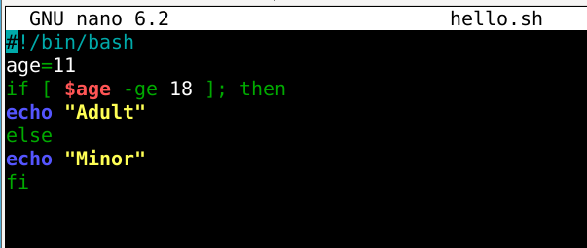
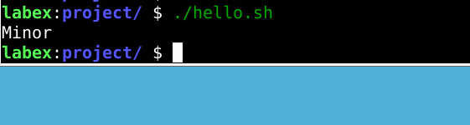
Basic Shell Scripting (if else Statement)

Slide 14
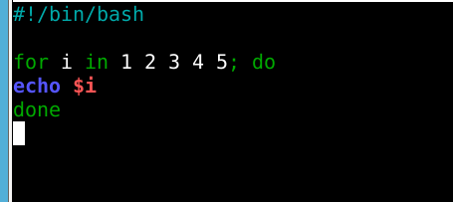
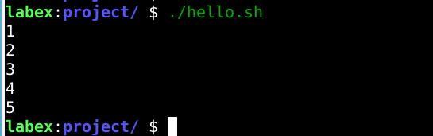
Basic Shell Scripting (Loops)
-For loop
Notes:
It always in on done

Slide 15
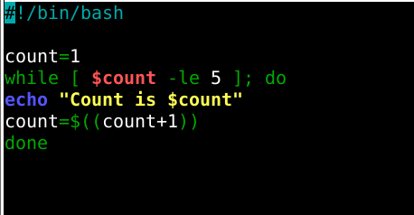
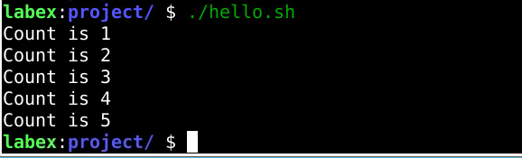
Basic Shell Scripting (Loops)
-while loop
Notes:
It always in on done

Slide 16
Basic Shell Scripting (Loops)
-while loop
Notes:
It always in on done

Slide 17
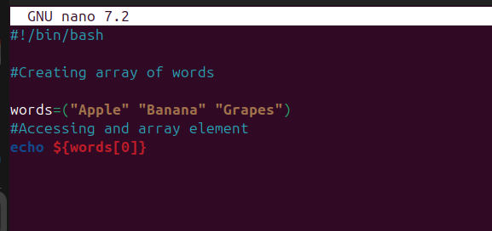
Basic Shell Scripting (Arrays)
Notes:
To access all elements of an array in Bash, use ${array[@]}:
bash
fruits=("apple" "banana" "cherry") echo "${fruits[@]}

Slide 18
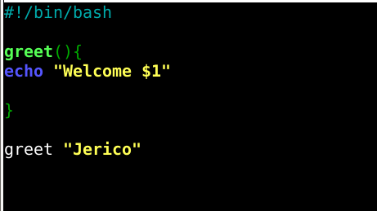

Basic Shell Scripting (Function)
Notes:
It always in on done echo "Good day, $1!"echo prints the message to the terminal. $1 refers to the first argument passed to the function.
$1 is a positional parameter used to get arguments inside functions.

Slide 19
Hands On
Use Case: Automatically back up a folder.
Notes:
#!/bin/bash
src="/home/user/documents"
dest="/home/user/backup_$(date +%F)"
mkdir -p "$dest"
cp -r "$src"/* "$dest"
echo "Backup completed to $dest"

Slide 20
Thank You
Notes:
sudo apt update && sudo apt upgrade -y

